Slide 1
Innovation for cOvide 19 Vaccine analysis
Phase 2 submission

Slide 2
Innovations in COVID-19 vaccine analysis have played a crucial role in the development, distribution, and monitoring of vaccines. Some key innovations include:
mRNA Vaccine Technology: The development of mRNA vaccines, like the Pfizer-BioNTech and Moderna vaccines, marked a groundbreaking innovation. These vaccines use genetic material to instruct cells to produce a spike protein found on the virus, triggering an immune response.

Slide 3
Real-time Monitoring: Advanced data analytics and real-time tracking systems have been implemented to monitor vaccine distribution, adverse events, and efficacy, allowing for rapid adjustments and improvements.
AI and Machine Learning: AI-driven algorithms have been used to analyze massive datasets, helping researchers identify potential vaccine candidates and predict virus mutations. AI has also aided in vaccine development by simulating protein structures and interactions.

Slide 4
Cold Chain Innovations: Maintaining the temperature integrity of vaccines during transportation and storage is vital. Innovations in cold chain technology, including specialized containers and temperature-monitoring sensors, have improved vaccine distribution.
Single-dose Vaccines: Innovations like the Johnson & Johnson vaccine, which requires only one dose, have simplified the vaccination process and increased accessibility.
Variant-Specific Vaccines: Adapting vaccines to new virus variants has become essential. Innovations in rapid vaccine development methods are helping to create variant-specific vaccines.

Slide 5
Vaccine Passport Apps: Digital vaccine passport apps have emerged to provide proof of vaccination, making it easier for individuals to access certain services and travel.
Mobile Vaccination Clinics: Mobile vaccination units have been deployed in various regions, bringing vaccines directly to underserved communities, increasing accessibility These innovations have accelerated the fight against COVID-19, from vaccine development to distribution and monitoring, and will continue to shape our response to future pandemics.

Slide 6
COVID-19 vaccines. Some notable innovations in this area include :
Vaccine Effectiveness Studies: Innovative study designs and statistical methods have been developed to assess how well vaccines work in real-world conditions. This involves analyzing data from large populations to determine vaccine effectiveness against various COVID-19 variants.
Adaptive Clinical Trials: Researchers have used adaptive trial designs, which allow for real-time adjustments based on emerging data. This has accelerated the vaccine development process and allowed for quicker identification of effective candidates.

Slide 7
AI and Machine Learning: AI-driven algorithms have been used to analyze massive datasets, helping researchers identify potential vaccine candidates and predict virus mutations. AI has also aided in vaccine development by simulating protein structures and interactions.
Cold Chain Innovations: Maintaining the temperature integrity of vaccines during transportation and storage is vital. Innovations in cold chain technology, including specialized containers and temperature-monitoring sensors, have improved vaccine distribution.

Slide 8
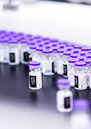
Four types of vaccine:
Subunit, recombinant, polysaccharide, and conjugate vaccines use specific pieces of the germ—like its protein, sugar, or capsid (a casing around the germ). Because these vaccines use only specific pieces of the germ, they give a very strong immune response that's targeted to key parts of the germ.

Slide 9
Single-dose Vaccines: Innovations like the Johnson & Johnson vaccine, which requires only one dose, have simplified the vaccination process and increased accessibility. Variant-Specific Vaccines: Adapting vaccines to new virus variants has become essential. Innovations in rapid vaccine development methods are helping to create variant-specific vaccines.
Mobile Vaccination Clinics: Mobile vaccination units have been deployed in various regions, bringing vaccines directly to underserved communities, increasing accessibility.

Slide 10
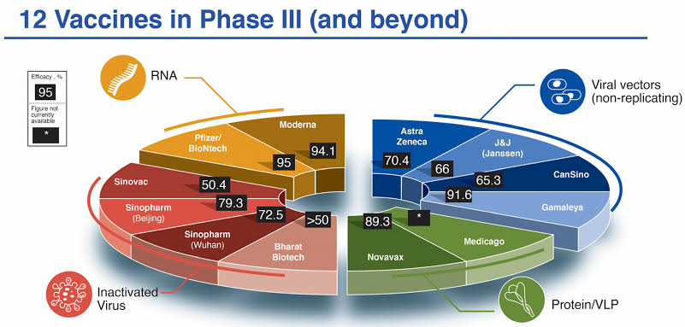

Slide 11
Conclusion:
These innovations collectively represent a remarkable response to a global health crisis, demonstrating the potential for rapid scientific progress and collaboration in the face of unprecedented challenges.

